Slide 1

Data driven offer creation
Request for Proposal
BAKERY & CO.
Javier de la Rúa Martínez, Daniel Mínguez Camacho

Slide 2


Index
Bakery & Co.
Structure
Problem
Proposal
  Starting point and Business Goal
  Tasks and Calendar
  Risks
  Technical goals and details
  Fees
  Signatures

Slide 3
Bakery & Co.
Bakery & Co. is a national bakery company that started as a family business twenty years ago in Madrid.
Since last ten years the company has experienced a large growth with the opening more that 50 new stores at a national level.
Each store operates individually from each other and reports to the central offices in Madrid.
Bakery & Co. Wants to develop a new data driven approach of managing the offers that it applies in each store and had request a proposal for applying offers in each store based on the sells that each one has.

Slide 4
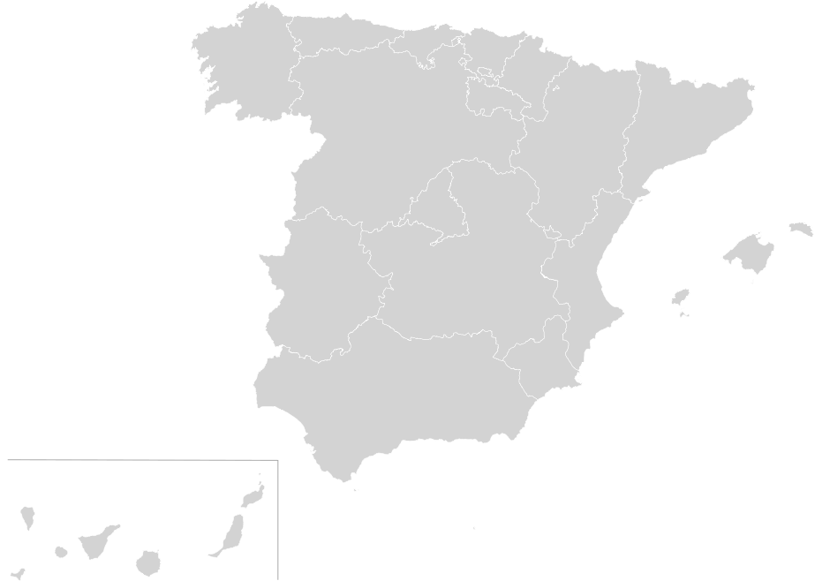
Structure
The main offices of Bakery & Co. Are located in Madrid.
From there they receive:
  Monthly incomes from each of the different stores
  Materials requests
  Incidents
The stores are managed by managers depending of its location and are separated in North (12) – Center (24) – South (14) and Mediterranean divisions (21). Each store has a store responsible.

Slide 5

Problem
At this moment each store responsible decide what offers to apply to each product/group of products and this information is difficult to be tracked from the central office of the company.
Bakery & Co. Wants to establish a centralized revenue model and a centralize-managed offers model.
In order to achieve this, the company has started to install a centralize ERP system, and wants to stablish a centralize model based on sells information for the definition of different offers

Slide 6
Proposal

Slide 7

Proposal
Who are we
We are XXX consulting, we have deliver analytics insights through a huge portfolio of clients
The personnel assigned to this projects are:
  1 Manager
  Javier, Senior Data Scientist
  Daniel, Senior Data Scientist
  2 programmers

Slide 8
Proposal
Starting point & Business Goal
Bakery & Co. needs to centralize offer manage process, in order to increase the effect of this offers, the number of sells and to facilitate the logistics between its shops.
Each shop operates individually, but there is a project aiming to centralize all stores in a single ERP.
We propose a 2 stage project in order to achieve the goal of apply a model to each store and a global model for the company.
Based on our previous experience, usual effects of this approach offers the following ROI:
  Increase in sales around 10-30%
  Reduce in the logistics cost by 15%
  Increase the information available to manage the stores.

Slide 9
Proposal
Tasks & Calendar
Stage 1 – Individual Bakery shop model (Pilot):
  Stablish a pilot model in one bakery in Madrid.
  Obtain records of transactions in the new ERP model format.
  Create a model and monitorize it in order to apply it to.
  The data Will be process offline, one first model Will be applied to historic data
Stage 2 – Implementation of the model:
  Implementation of the model by geography.
  Analysis of the results.
Stage 3 – Centralized model:
  Stablish an aggregate company model with each individual model.
  Stablish a second model, which Will include new data generated and which offers are stablished.
  Manage logistics and offers.

Slide 10
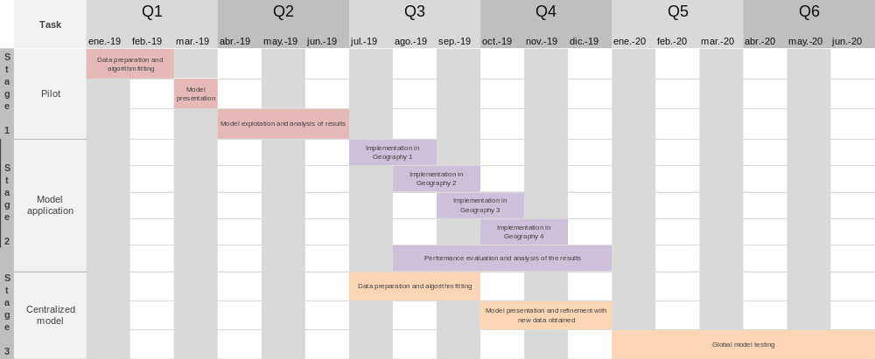

Proposal
Tasks & Calendar
Deliverable

Slide 11
Proposal
Tasks & Calendar - Approach
In the present document we offer the contract and details for the first stage of the Project.
Based on the evolution of the pilot and depending of the interests of Bakery & Co. We Will present the details of the rest of stages

Slide 12
Pilot

Slide 13
Proposal
Tasks & Calendar - Pilot
We include the proposal for the pilot
Problem analysis (4h):
  Kick off meeting
  Understanding of the data
  Data cleaning & Data pre-processing
Algorithm selection and tuning, preparation of the results (4h):
  Algorithm matching and tuning
  Selection of the more optimal algorithm
Presentation meeting (1h):
  Feedback and possible upgrades
Final adjustments and implementation (2h):
  Implementation of the feedback upgrades
  Final deliverables (Report with algorithm used, results and conclusions).
Monthly meetings for analysing the results

Slide 14
Proposal
Tasks & Calendar - Pilot
Week | Monday | Tuesday | Friday | Thursday | Friday
January 7th-11th | Kick off meeting (1) | Problem analysis and Algorithm selection (1-2) |  | Presentation of results meeting (3) | Final adjustments and deliverable delivery (4)
January 14th-18th
January 21th-25th
January 28th-1st
February 4th-8th
February 11th-15th
February 18th-22th
February 25th-1st

Slide 15
Proposal
Technical goals and details - Pilot
Technical goals
  Find which products are sold together during weekdays at lunch times using an a priori algorithm.
Data preparation tasks:
  Formatting for processing in R.
  Data exploration and basic information extraction:
    More frequent items sold
    Trends by week day and month
    Average of items per transaction
    …
Modelling tasks:
  Execution of the algorithm using different parameters for support and confidence.
  Analysis of the results and selection of the best model.
Analysis of the results and benefits:
  The results will be delivered with a recommendation for which group of items are more suitable for being targets of offers. It will be supported by the graphs and results obtained in R.

Slide 16
Proposal
Risks
The following risks are not taking into account in the schedule
Delay in the developmet of the solution due to problems in data formatting or delivering by the company personnel.
Delay in the implementation of the solution due to a delay in the implementation of the ERP in the different geographies
Inconsistent results due to a lack of advertisement of the offers.

Slide 17
Proposal
Requirements & next steps - Pilot
Requirements:
  The meetings should be agreed in the kick-off meeting and depending of this the final calendar could be subject to changes.
  In the case of finding some inconsistencies in the data that could drive into extra pre-processing, a notification will be sent with the problem and the correspondent new proposed calendar.
Next steps (not in scope):
  In order to analyse the results of the algorithm and the offers that will be made, we proposed the following KPI:
  Nº of products sell before offers / Nº of products sell after offers
  Use of alternatives algorithms for analyse the problem like FP-Growth algorithm.

Slide 18
Proposal
Fees - Pilot
The following are the fees agreed for the project. This fees does not include expenses neither taxes:
Type | Hours | Fees
Manager | 1 | 200€
Senior DS
Analyst | 10 | 1.000€
 | 11 | 1.200€

Slide 19
Proposal
Signs
Both bakery & Co. and Consulting firm legal departments will agree in the terms of the present contracts regarding invoicing, data protection and other terms
Bakery & Co.
Consulting firm

